Slide 1
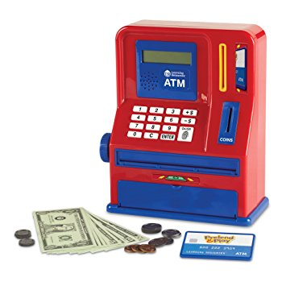
ATM Project
Mary Husain | Michal Porubcin | Andrew Quijano | Bryce Yoo
Notes:
Mary Husain
Michal Porubcin
Andrew Quijano
Bryce Yoo

Slide 2
Members
Mary Husain
Michal Porubcin
Andrew Quijano
Bryce Yoo

Slide 3
Overview

Slide 4
Features

Slide 5
Encryption and Security

Slide 6
User Interface

